Slide 2
Types of Contaminants in Fresh Water
1. Dissolved / particulate
2. Organic / inorganic
Loading
How much of the contaminant is added to water
Physical, Chemical and Biological Transformation
Reactions in water leading to formation/destruction of contaminants
Physical Transport, i.e., Mass Transport
How the contaminant is spread in the water
Mass Transfer
Transfer of contaminant from water to soil and air
Factors Determining Concentration of Contaminants

Slide 3
Processes Undergone by Contaminants in Water
Biological / chemical processes involving dissolved contaminants
Acid-Base Reaction organic / inorganic
Complexation Reaction organic / inorganic
Precipitation Reaction inorganic
Oxidation-Reduction organic / inorganic
Hydrolysis mostly organic (will be briefly discussed)
Photolysis mostly organic (will be briefly discussed)
Biodegradation mostly organic (will be briefly discussed)
Physical processes involving particulate contaminants
Sedimentation
Coagulation / flocculation
Filtration
3. Mass transport of dissolved / particulate contaminants
Advection
Diffusion / Dispersion
Mass transfer of dissolved contaminants
Solid-liquid mass transfer adsorption / desorption
Gas-liquid mass transfer absorption / stripping

Slide 5
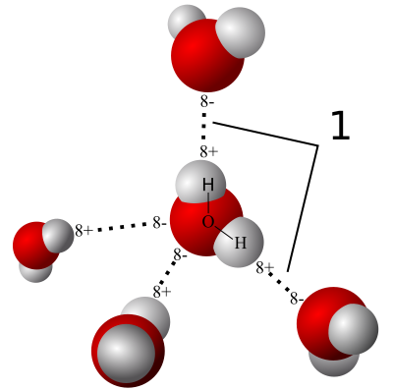
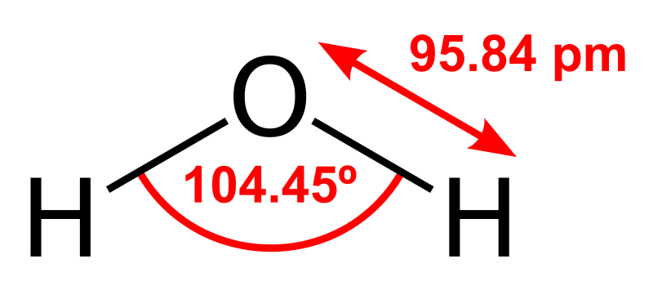
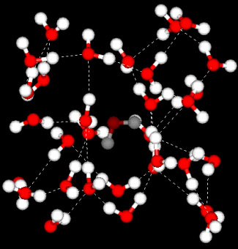
General Properties of Water
Formula: H₂O
Molecular Mass: 18 g / mole
Density: 1000 kg/m³
Hydrogen Bonds
The negative parts of a water molecule are attracted to the positive parts of other water molecules, i.e., they form hydrogen bonds.
Each water molecule can form up to 4 hydrogen bonds. This is the reason why water molecules stick to each other and form droplets.
Polarity of Water
Water is a polar molecule. The extremity of the molecule having oxygen atom has an excess negative charge. The other two extremities have excess positive charge.
Water as a Solvent
Due to its polarity, hydrogen bond forming ability and also due to the presence of large void spaces between molecules, water can dissolve a large variety of ionic and polar compounds.
Structure of Water
Three-dimensional depiction of the structure of water shows large void spaces between molecules.

Slide 6
Acid-Base Chemistry
Acid: An acid is any chemical, which when added to pure water (pH = 7) results in a pH decrease.
This means that addition of an acid to water results in the increase in the concentration of H⁺ ions in water (and corresponding decrease in OH⁻ ion concentration). Remember, [H⁺].[OH⁻] = 10⁻¹⁴ always.
Base: A base is any chemical, which when added to pure water (pH = 7) results in a pH increase.
This means that addition of a base to water results in the increase in the concentration of OH⁻ ions in water (and corresponding decrease in H⁺ ion concentration).
Strong Acid: A strong acid, when added to water is completely dissociated, producing an equivalent quantity of H⁺ ions.
HCl is a strong mono-protic acid. When added to water, it completely dissociates, releasing equivalent quantity of H⁺ ions, . So if 1 mole of HCl is added to water, 1 mole of H⁺ and 1 mole of Cl⁻ will be released into the water. No HCl will remain in the water.
is a strong bi-protic acid. , so if 1 mole of is added to water, 2 moles of H⁺ and 1 mole of will be released into water. No will remain in water.

Slide 7
What is the Concentration of Water in Water ??
1-liter of water weighs 1000 g.
1 gm-mole of water = 18 g
No. of gm-moles in 1-liter of water = 1000/18 =55.55
Hence, concentration of water in water is 55.55 M
However, the above statement is not completely correct, since pure water is partially dissociated as below,
Since water is electrically neutral, [H⁺] = [OH⁻] = 10⁻⁷ M
Hence, pH of pure water is 7.

Slide 8
Strong Base: A strong base, when added to water is completely dissociated, producing an equivalent quantity of OH⁻ ions.
NaOH is a strong base. When added to water, it completely dissociates, releasing equivalent quantity of OH⁻ ions, . So if 1 mole of NaOH is added to water, 1 mole of OH⁻ and 1 mole of Na⁺ will be released into the water. No NaOH will remain in the water.
Example Problem:
What is the pH of 10⁻³ M HCl solution ?
[Cl⁻] = 10⁻³ M
[H⁺].[OH⁻] = 10⁻¹⁴
Charge Balance: [H⁺] = [OH⁻] + [Cl⁻]
pH = 3

Slide 9
Class Problem
On a piece of paper provided to you, please answer the following question. Write your name and roll number before submitting the sheet today.
What is the pH of 10⁻² M H₂SO₄?
What is the pH of 10⁻³ M NaOH?

Slide 10
Example Problem:
What is the pH of 10⁻⁸ M HCl solution ?
[Cl-] = 10⁻⁸ M
[H⁺].[OH⁻] = 10⁻¹⁴
Charge Balance: [H⁺] = [OH⁻] + [Cl⁻]
pH = 6.978
Solve the following problems:
What is the pH of 10⁻⁴ M H₂SO₄ solution?
What is the pH of 10⁻⁸ M NaOH solution?

Slide 12
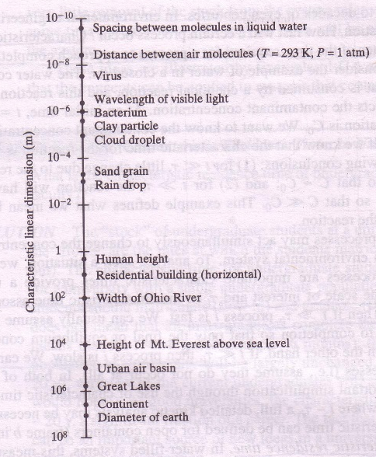
Relative Sizes of Environmental Constituents

Slide 13
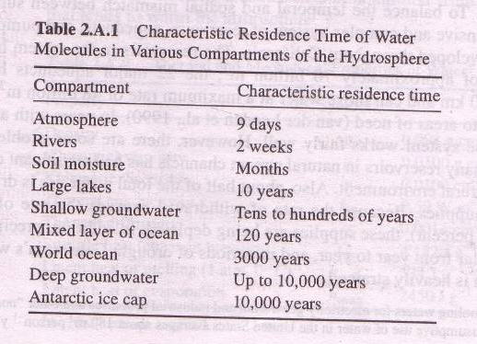
Residence Times of Water Molecules

Slide 15
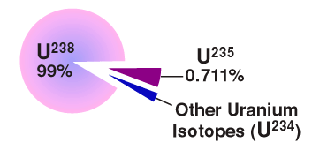
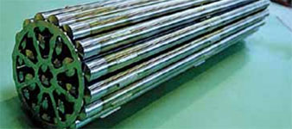
Environmental Issues of Inorganic Contaminants in India
Carcinogenic Arsenic in Groundwater
Excessive Fluoride in Groundwater
Source: Chakraborti et al. ES&T 2011
Uranium Processing and Long-term Storage
Source: Chakraborti et al. ES&T 2011
Source: K.M. Gunderson

Slide 16
Historical Perspective on Groundwater Quality Management in India
~1940s: Water from surface water sources like rivers, ponds, rainwater, etc.
Mid 20th century challenges:
Shortage of food due to excessive population growth
Prevalence of water-borne diseases like cholera, dysentery, etc. (GOI Environmental Hygience Commmitte, 1949)
Need for Groundwater sources for agricultural and domestic water needs
Early 1960s: Expansion in groundwater use due to electrical subsidies, decreasing tubewell costs, financial credit availability Green Revolution
WHO and UNICEF proposed use of groundwater for safe drinking water
1969: National Rural Drinking Water Supply Programme was launched
2005: Bharat Nirman Programme to develop rural drinking water and irrigation systems; every household targeted by 2009 (still to be realized)
Source: Chakraborti et al. Environmental Science and Technology (2011)
Source: Chakraborti et al. Environmental Science and Technology (2011)

Slide 17
Groundwater Use and Major Pollutants…1
Usage: ~80 % of rural India and ~50% of urban India for domestic purposes
~33% of country’s groundwater resources are unfit for consumption (TOI, Mar 2010)
Anthropogenic Contaminant Sources:
Sewage Disposal: Bacteria (only ~10 % of urban sewage is treated), Nitrate
Agriculture: Nitrate (11 of 28 States in India and ~22% of villages in Rajasthan have more than 45 ppm)
Pesticide (long-term source)
Industry: Heavy Metals (Cr, Cd, Ni, Hg, As); Organics through untreated discharge Waste from Paris-Green insecticide production caused As contamination in Kolkata (1993); Chromite ore processing residue in areas near Kanpur and Chennai;
Source: Chakraborti et al. Environmental Science and Technology (2011)

Slide 18
Groundwater Use and Major Pollutants…2
Geogenic Contaminant Sources:
Fluoride: Fluorosis is the most prevalent groundwater-related disease in India (the most severely affected country worldwide)
~66 million people affected in India; ~20 States have some districts
Arsenic: Primarily in the floodplains of Ganga-Brahmaputra Plains
Iron: Largest pollutant among heavy metals
Salinity (predominantly, Cl⁻ salts): due to seawater ingress in coastal areas
inappropriate agricultural practices
Source: Chakraborti et al. Environmental Science and Technology (2011)

